Slide 1

HTTP and HTML Basics
HTTP Request & Response, HTML, Working with Forms
SoftUni Team
Technical Trainers
Software University
https://softuni.bg

Slide 2
Table of Content
HTTP Basics
Dev Tools
URL
Request and Response
HTML Basics
Definition and Tools
Forms, Escaping and Checkboxes

Slide 3
Request and Responses
HTTP://

Slide 4



HTTP Basics
HTTP (Hyper Text Transfer Protocol)
Text-based client-server protocol for the Internet
For transferring Web resources (HTML files, images, styles, etc.)
Request-response based
HTTP request
HTTP response
Web Client
Web Server

Slide 5



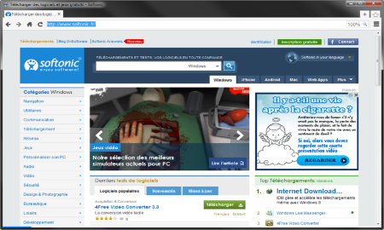





Web Server Work Model
Web Client
Web Server
Technology
Request
Response
Web Resources
Database
HTML, PDF, JPG…

Slide 6

Tools for Developers

Slide 7


HTTP Developer Tools
Postman
Insomnia

Slide 8

URL
Uniform Resource Locator

Slide 9
Uniform Resource Locator (URL)
http://mysite.com:8080/demo/index.php?id=27&lang=en#lectures
Protocol
Host
Port
Path
Query String
Fragment
Protocol for communicating (http, ftp, https...) - HTTP in most cases
Host or IP address (www.softuni.bg, gmail.com, 127.0.0.1, web)
Port (the default port is 80) - a number in range [0…65535]
Path (/forum, /path/index.php)
Query string (?id=27&lang=en)
Fragment (#lectures) - used on the client to navigate to some section

Slide 10

What is a HTTP Request?

Slide 11

HTTP Request Methods
HTTP defines methods to indicate the desired action to be performed on the identified resource
GET
POST
HEAD
PUT
DELETE
CONNECT
OPTIONS

Slide 12
HTTP GET Request - Example
GET /users/SoftUni-Tech-Module/repos HTTP/1.1
Host: api.github.com
Accept: */*
Accept-Language: en
Accept-Encoding: gzip, deflate
User-Agent: Mozilla/5.0 (Windows NT 10.0; WOW64) AppleWebKit/537.36 (KHTML, like Gecko) Chrome/54.0.2840.71 Safari/537.36
Connection: Keep-Alive
Cache-Control: no-cache
<CRLF>
HTTP request line
HTTP headers
The request body is empty

Slide 13
HTTP POST Request - Example
POST /repos/Tech-Module-Jan-2018/test-repo/issues HTTP/1.1
Host: api.github.com
Accept: */*
Accept-Language: en
Accept-Encoding: gzip, deflate
User-Agent: Mozilla/4.0 (compatible;MSIE 6.0; Windows NT 5.0)
Connection: Keep-Alive
Cache-Control: no-cache
<CRLF>
{"title":"Found a bug",
"body":"I'm having a problem with this.",
"labels":["bug","minor"]}
<CRLF>
HTTP request line
HTTP headers
The request body holds the submitted data

Slide 14

What is a HTTP Response?
HTTP Response

Slide 15
HTTP Response - Example
HTTP response status line
HTTP/1.1 200 OK
Date: Fri, 11 Nov 2016 16:09:18 GMT+2
Server: Apache/2.2.14 (Linux)
Accept-Ranges: bytes
Content-Length: 84
Content-Type: text/html
<CRLF>
<html>
<head><title>Test</title></head>
<body>Test HTML page.</body>
</html>
HTTP response headers
HTTP response body

Slide 16
HTTP Response Status Codes
Status Code | Action | Description
200 | OK | Successfully retrieved resource
201 | Created | A new resource was created
204 | No Content | Request has nothing to return
301 / 302 | Moved | Moved to another location (redirect)
400 | Bad Request | Invalid request / syntax error
401 / 403 | Unauthorized | Authentication failed / Access denied
404 | Not Found | Invalid resource
409 | Conflict | Conflict was detected, e.g. duplicated email
500 / 503 | Server Error | Internal server error / Service unavailable

Slide 17
Content-Type and Disposition
The Content-Type / Content-Disposition headers specify how the HTTP request / response body should be processed
JSON-encoded data
UTF-8 encoded HTML page. Will be shown in the browser
Content-Type: application/json
Content-Type: text/html; charset=utf-8
Content-Type: application/pdf
Content-Disposition: attachment; filename="Financial-Report-April-2016.pdf"
This will download a PDF file named Financial-Report-April-2016.pdf

Slide 18
HTTP Conversation: Example
GET /trainings/courses HTTP/1.1
Host: www.softuni.bg
User-Agent: Mozilla/5.0
<CRLF>
The empty line denotes the end of the request header
REQUEST
The empty line denotes the end of the response header
HTTP/1.1 200 OK
Date: Tue, 16 Jan 2018 15:13:41 GMT
Server: Microsoft-HTTPAPI/2.0
Last-Modified: Tue, 16 Jan 2018 15:13:42 GMT
Content-Length: 18586
<CRLF>
<html><title>Курсовете от…
</title>
RESPONSE

Slide 19

HTML
What is HyperText Markup Language?

Slide 20
What is HTML?
HTML - HyperТext Markup Language
A text-based notation for describing
document structure (semantic markup)
document content (text + images + others)
formatting (presentation markup)
A HTML document consists of many tags (with nesting)
A web site consists of many HTML documents (cross-linked) + images + CSS styles + scripts + other assets

Slide 21
HTML Terminology
Tags - keywords describing the document structure
Attributes - properties of the tag, e.g. size, color, etc…
Elements - opening + closing tag + attributes + content
Opening tag
Attribute: key = "value"
<a href="/home">
Navigate to
<b>home page</b>
</a>
Element
Closing tag

Slide 22
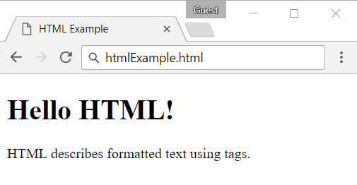
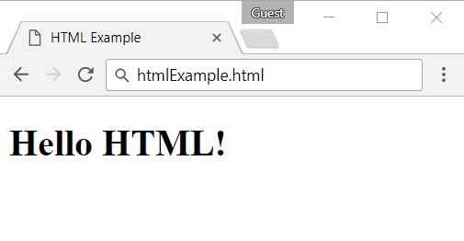
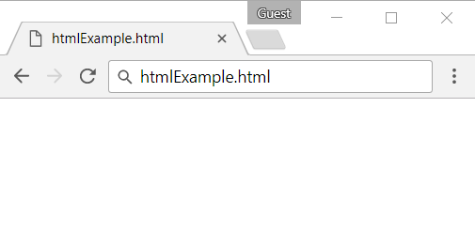
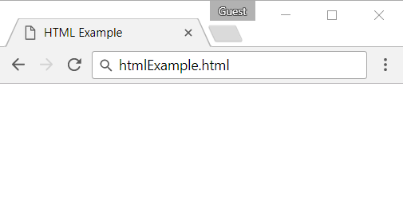
HTML Page - Example
<!DOCTYPE html>
<html>
<head>
<title>HTML Example</title>
</head>
<body>
<h1>Hello HTML!</h1>
<p>HTML describes formatted text using tags.</p>
</body>
</html>

Slide 23
Populate HTML Tags
Structured
h1, h2, h3
div, span, p
table, th, tr, td
img , script, style
ul, ol, li
article, nav
Interactive
a
form
input
select
button

Slide 24
Document Structure
HTML 5 defines semantic tags for layout
<header>, <footer>, <nav>, <aside>, <section>
<html>
<head> … </head>
<body>
<header> … </header>
<nav> … </nav>
<aside> … </aside>
<section> … </section>
<footer> … </footer>
</body>
</html>
Logo + Header
Navigation
Content
Sidebar
Footer

Slide 25
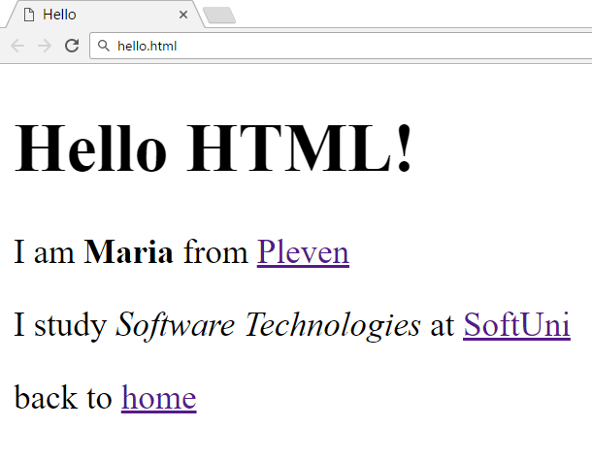
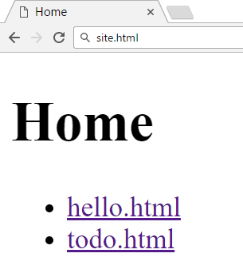
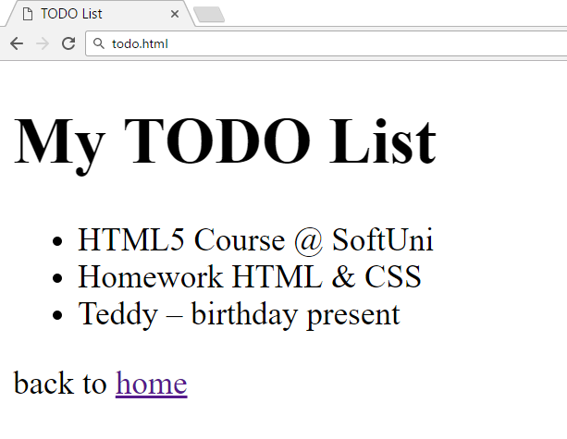
Exercise: Website
Create a three-page Web site
Create page
home.html
Link it with both
hello.html
todo.html
In both files create
link "back to home"

Slide 26

Live Exercises

Slide 27




Developer Environments

Slide 28


HTML - Developer Environments
WebStorm
Powerful IDE for HTML, CSS and JavaScript, paid product
Visual Studio + Node.js Tools
For many languages and technologies, Windows only
Visual Studio Code, Brackets, NetBeans
Good free tools for HTML5, cross-platform
Sublime Text, Vim, Notepad++
For hackers

Slide 29

HTML Forms
Working with Forms

Slide 30
HTTP Forms - Request Methods
Forms allow the user to enter data that is sent to a server for processing via HTTP request methods
GET and POST are the most used HTTP methods
The form data is stored in the $_GET or $_POST associative arrays
<form>
First name: <input type="text" name="firstname"><br>
Last name: <input type="text" name="lastname"><br>
<input type="submit" value="Submit">
</form>

Slide 31
GET Request Method
HTTP GET
Retrieves data from the server from given URL
The form data is stored in $_GET associative array
The whole query string can be accessed using $_SERVER['QUERY_STRING'] environment variable
<form method="get" action="index.php">
…
</form>

Slide 32
GET Request Method - Example
<form method="get">
Name: <input type="text" name="name" />
Age: <input type="text" name="age" />
<input type="submit" />
</form>
<?php
// Check the keys "name" or "age" exist
if (isset($_GET["name"]) || isset($_GET["age"])) {
echo "Welcome " . htmlspecialchars($_GET['name']) . ". <br />";
echo "You are " . htmlspecialchars($_GET['age']). " years old.";
}
?>

Slide 33
POST Request Method
The POST method transfers data in the HTTP body
Not appended to the query string
The posted data is stored in $_POST associative array
By using https:// you can protect your posted data
POST can send text and binary data, e.g. upload files
<form method="post" action="index.php">
…
</form>

Slide 34
POST Request Method - Example
<form method="post">
Name: <input type="text" name="name" />
Age: <input type="text" name="age" />
<input type="submit" />
</form>
<?php
// Check the keys "name" or "age" exist
if (isset($_POST["name"]) || isset($_POST["age"])) {
echo "Welcome " . htmlspecialchars($_POST['name']) . ". <br />";
echo "You are " . htmlspecialchars($_POST['age']). " years old.";
}
?>

Slide 35
Live Exercises

Slide 36

HTML
Escaping & Data Validation

Slide 37
HTML Escaping: Motivation
Suppose we run this PHP script
What if we enter the following in the input field?
<form method="get">
Enter your name: <input type="text" name="name" />
<input type="submit" />
</form>
<?php
if (isset($_GET["name"]))
echo "Hello, " . $_GET["name"];
?>
<script>alert('hi')</script>

Slide 38
HTML Escaping: Htmlspecialchars()
htmlspecialchars(string)
Converts HTML special characters to entities: & " ' < and > become &amp; &quote; &#039; &lt; and &gt;
<form method="get">
Enter your name: <input type="text" name="name" />
<input type="submit" />
</form>
<?php
if (isset($_GET["name"]))
echo "Hello, " . htmlspecialchars($_GET["name"]);
?>

Slide 39

Principles of HTML Escaping
How and when the HTML escape?
HTML escaping should be performed on all data printed in an HTML page, that could contain HTML special chars
Any other behavior is incorrect!

Slide 40
Principles of HTML Escaping
Never escape data when you read it!
Escape the data when you print it in a HTML page
Never store HTML-escaped data in the database!
Never perform double HTML escaping

Slide 41
Example of Correct HTML Escaping
Sample form that can submit HTML special characters
Example of correct HTML escaping (data only!)
<form method="get">
Name: <input type="text" name="name" value="&lt;br&gt;" />
<input type="submit" />
</form>
<?php
if (isset($_GET["name"]))
echo "Hi, <i>" . htmlspecialchars($_GET["name"] . "</i>");
?>

Slide 42
Example of Incorrect HTML Escaping
Sample form that can submit HTML special characters
Example of incorrect HTML escaping (don't escape everything)
<form method="get">
Name: <input type="text" name="name" value="&lt;br&gt;" />
<input type="submit" />
</form>
<?php
if (isset($_GET["name"]))
echo htmlspecialchars("Hi, <i>" . $_GET["name"] . "</i>");
?>

Slide 43
Data Normalization
addcslashes - escapes given list of characters in a string
quotemeta - escapes the symbols . \ + * ? [ ^ ] ( $ )
htmlspecialchars - convert special characters to HTML entities, as seen in examples
htmlentities - escapes all HTML entities (£ → &pound;)
Escapes special symbols in a string: &, ", ', <, >

Slide 44
PHP Automatic Escaping Engine - WARNING!
PHP supported the magic_quotes engine
It escapes all necessary characters in the $_GET, $_POST and $_COOKIE array automatically
In versions before 5.2 it is turned on by default
Considered dangerous approach - deprecated in PHP 5.4
Developers should handle escaping manually

Slide 45
Validating User Input
Data validation ensures the data we collect is correct
May be performed by filter_var() in PHP
<?php
$ip_a = '127.0.0.1';
$ip_b = '42.42';
if (filter_var($ip_a, FILTER_VALIDATE_IP)) {
echo "This (ip_a) IP address is considered valid.";
}
if (filter_var($ip_b , FILTER_VALIDATE_IP)) {
echo "This (ip_b) IP address is considered valid.";
}
?>

Slide 46
Live Exercises

Slide 47

Checkboxes
Working with Checkboxes

Slide 48
Checkboxes
Checkboxes are created by setting an input with type "checkbox"
<input type="checkbox" name="two-way-ticket" />
A checkbox is only submitted if it's actually checked
if (isset($_GET['two-way-ticket']) ) {
echo "Two-way ticket";
} else {
echo "One-way ticket";
}

Slide 49

Hidden Fields

Slide 50
Hidden Fields
Created by setting the type of input to hidden
Submit information that is not entered by the user
Not visible to the user, but visible with [F12]
<form method="post">
<input type="text" name="user" />
<input type="submit" />
<?php if (isset($_POST['user'])) { ?>
<input type="hidden" name="hiddenName"
value="<?php echo sha1($_POST['user']) ?>" />
<?php } ?>
</form>
Applies sha1 hashing to a string

Slide 51

Submitting Arrays

Slide 52
Submitting Arrays
In order for an input to be treated as an array, you must put brackets "[]" in the name attribute
<form method="post">
<select name="people[]" multiple="multiple">
<option value="Mario">Mario</option>
<option value="Svetlin">Svetlin</option>
<option value="Teodor">Teodor</option>
</select>
<input type="submit" value="submit"/>
</form>

Slide 53
Submitting Arrays (2)
The selected form elements come as an array
<?php
if (isset($_POST['people'])) {
foreach($_POST['people'] as $person) {
echo htmlspecialchars($person) . '</br>';
}
}
?>

Slide 54
Other Input Types
Radio, date, datetime, time, number, range, color and other
<form method="post">
Male <input type="radio" name="gender" value="male" /> <br/>
Female <input type="radio" name="gender" value="female" /> <br/>
<input type="submit" value="submit"/>
</form>
<?php
if (isset($_POST['gender'])) {
$selected_radio = $_POST['gender'];
echo "Selected: $selected_radio";
}
?>

Slide 55

Summary
…
…
…
HTTP works with message pairs called HTTP request and HTTP response
HTML describes text with formatting, images, tables, forms, etc
You can easily combine PHP and HTML
You can get input as array
Special input fields - checkboxes, hidden fields

Slide 56
Questions?
Notes:
56

Slide 57

License
This course (slides, examples, demos, exercises, homework, documents, videos and other assets) is copyrighted content
Unauthorized copy, reproduction or use is illegal
© SoftUni - https://about.softuni.bg/
© Software University - https://softuni.bg
Notes:
57

Slide 58
Trainings @ Software University (SoftUni)
Software University - High-Quality Education, Profession and Job for Software Developers
softuni.bg, about.softuni.bg
Software University Foundation
softuni.foundation
Software University @ Facebook
facebook.com/SoftwareUniversity
Software University Forums
forum.softuni.bg
Notes:
58

